Slide 1
Project Name: Skill Swap
Members: Talin Keshesh, Sako Asatryan, Zakir Rizvi, BachViet Nguyen, Justin Kalski

Slide 2
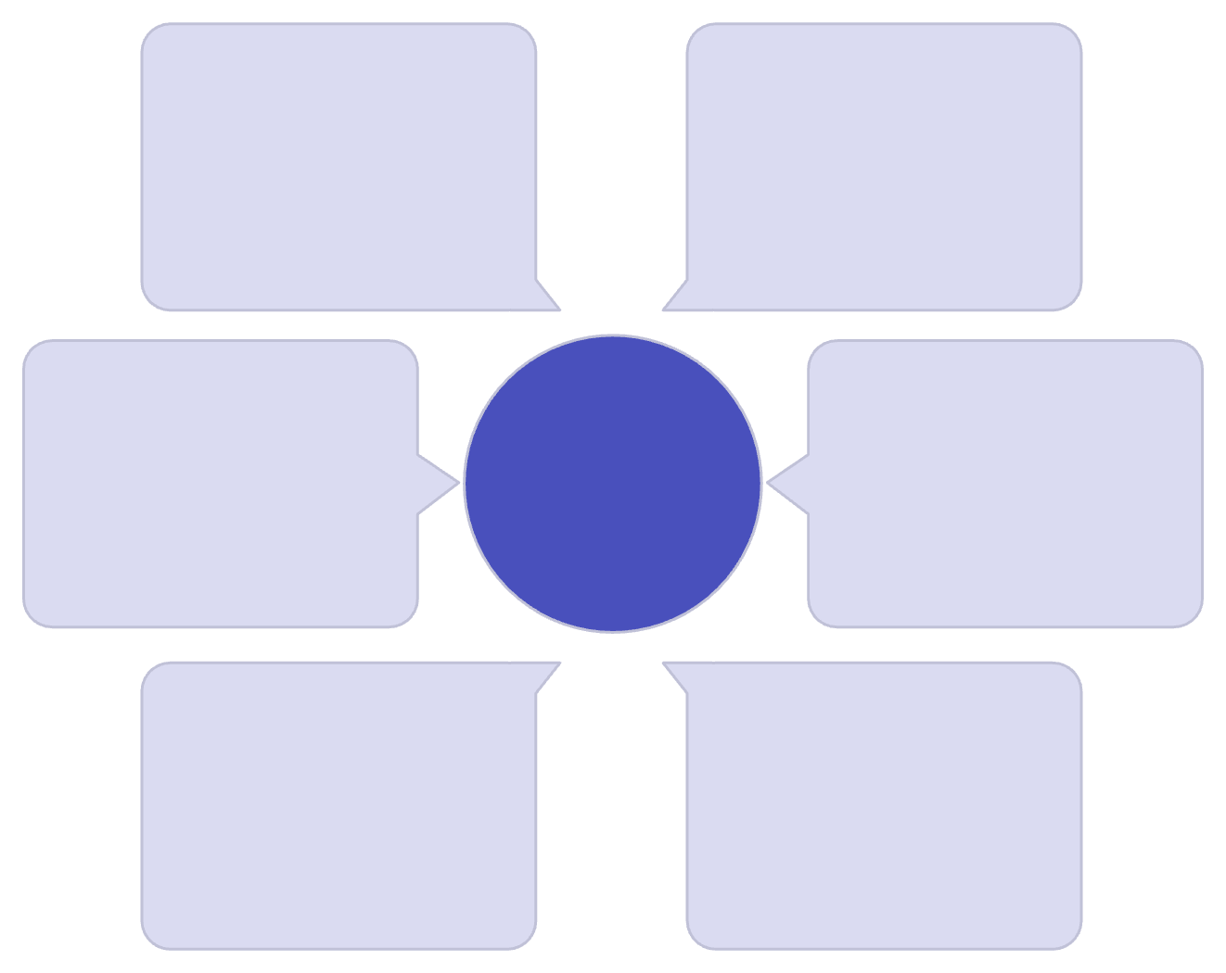
Tech Stack
Skill Swap is built with a robust and scalable tech stack designed for a seamless user experience. Flutter and Dart form the foundation for our cross-platform mobile application, ensuring a native feel on both iOS and Android. User management and security are handled by Firebase Authentication.
Firebase FCM
Flutter & Dart
Push notifications
Cross-platform mobile UI
Cloud Firestore serves as our NoSQL database, enabling real-time data synchronization for user profiles, skill listings, and messaging. Firebase Cloud Functions provide serverless backend logic, triggering actions like processing new skill uploads or generating notifications.
Firebase Storage
Firebase Authentication
Skill Swap Tech Stack
Media and file hosting
User sign-in and security
For media storage, we leverage Firebase Storage for user-generated content like profile pictures and skill demonstration images. Real-time communication and alerts are powered by Firebase Cloud Messaging (FCM). To ensure users can quickly find the skills and connections they need, we integrate Algolia for powerful and fast search capabilities.
Cloud Functions
Cloud Firestore
Serverless backend logic
Real-time database storage
Finally, Pinecone is utilized as a vector database for advanced AI-powered similarity search, enhancing our skill matching algorithm and providing personalized recommendations based on user interests and expertise.

Slide 3

Objective & Overview
Skill Swap is designed to facilitate a community where users can exchange valuable skills directly, bypassing traditional monetary transactions. Our core objective is to create an accessible platform for learning and collaboration, making education and skill development free and easy for everyone.
Imagine a student proficient in playing the guitar who needs help with Calculus 2. Through Skill Swap, they can connect with another student who excels in Calculus and is eager to learn guitar. Agreements for skill exchange, including duration and specifics, are seamlessly set up and managed directly within the app.
This initiative aims to empower individuals to share their expertise, learn new things, and foster a supportive environment where knowledge is the primary currency. We believe in unlocking human potential by making learning and collaboration universally available.

Slide 4
AI-Enhanced User Experience & App Flow
AI Agents: Powering Performance & Experience
Seamless User Onboarding
Connecting & Swapping
Welcome Page A friendly introduction to Skill Swap's mission and benefits.
Dashboard A personalized overview showcasing relevant skill swap users and potential matches based on profile information.
Our platform leverages multiple advanced AI agents to ensure a superior user experience and streamlined development process:
Authentication Secure login via OAuth (Google/Apple) or email. All credentials are safely stored in Firebase for robust security.
Debugging & Optimization: AI agents assist programmers in identifying and resolving bugs swiftly, and continuously optimize code for peak performance.
Browse/Search Users can actively search for other members by name, specific skills, or geographical location.
Profile Setup Users create detailed profiles, highlighting skills they can offer and skills they wish to learn. This data powers our matching algorithms.
Profile Examination Detailed viewing of other users' profiles to assess compatibility and potential swap opportunities.
Minimal Bugs: Proactive bug detection leads to a more stable and reliable application.
Connection Initiate contact and send skill swap requests to other users.
Optimal Load Times: AI-driven optimizations guarantee fast loading speeds, enhancing user satisfaction.
Matches Tab Manages all agreed connections and pending match requests, providing a central hub for ongoing skill exchanges.
Personalized Experience: These agents will eventually learn user preferences to suggest more relevant skill swap opportunities.

Slide 5




Messaging, Swaps & Rating System
Discuss & Connect
Propose & Agree
Initiate conversations with potential swap partners to delve into skill levels, discuss project scope, and confirm compatibility before committing to a swap.
Once details are ironed out, either user can propose a formal skill swap. Both parties receive notifications and must agree to finalize the exchange, ensuring mutual understanding.
Comprehensive Rating
Mutual Evaluation
After a swap is completed, a detailed 3-part rating system helps build trust and accountability within the community:
Both users rate each other on all three criteria, and these individual scores are averaged to contribute to a comprehensive full rating visible on their profiles, promoting transparency and quality interactions.
Response Time: How promptly did they communicate?
Reliability/Culpability: Did they follow through and deliver as promised?
Overall Personality: Was it a pleasant and respectful interaction?

Slide 6

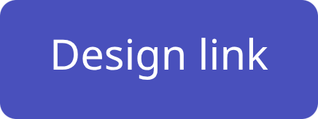
Project Design
Explore our interactive prototype and see the application come to life. This demo provides a comprehensive look at the user experience and key features.

Slide 7





Project Goals
Usability
Efficiency
The app should be simple for anyone to use with clear navigation, simple text, and AI agent guidance using plain language.
All designs are made before coding for easy changes, minimal layout, and logical screen flow to avoid confusion.
Community Building
Accessibility
Foster trust and meaningful connections between users, enabling them to confidently share and learn new skills.
Ensure skill exchange is free and available to everyone, regardless of economic background or geographical location.
Security & Privacy
Protect user data and ensure safe interactions within the platform, maintaining a secure and trustworthy environment.

